Slide 1
Customer Relationship management [data analyst project] Vishal Kumar

Slide 2
Contents
Introduction
List of KPI’s
Excel Dashboard
Tableau Dashboard
Power Bi Dashboard
SQL Queries Image
Final tips & Key takeaways

Slide 3
Summary about the Project
CRM analytics helps businesses track customer interactions, sales performance, and marketing effectiveness to drive data-driven decisions.
🔍 Key Insights:
Sales Performance Analysis: Identifies top-performing products, regions, and sales teams.
Customer Segmentation: Groups customers based on behaviour, demographics, and purchase patterns.
Lead Conversion Tracking: Measures lead-to-customer conversion rates and identifies bottlenecks.
Revenue Forecasting: Predicts future sales trends based on historical data.
Customer Retention Analysis: Tracks churn rates and customer lifetime value (CLV).
📈 Benefits: ✅ Improved decision-making with real-time insights ✅ Enhanced customer engagement and retention strategies ✅ Increased sales efficiency and revenue growth ✅ Optimized marketing campaigns based on data-driven recommendations

Slide 4
List of kpi’s
Opportunity Dashboard
Expected Amount
Active Opportunities-Total count of open opportunities.
Conversion Rate-Conversion Rate (%)=(Closed Won Opportunities/Total Opportunities​)×100
Win Rate-Win Rate (%)=(Closed Won Opportunities/Total Opportunities​)×100
Loss Rate-Loss Rate (%)=(Closed Lost Opportunities/Total Opportunities​)×100
Trend Analysis
Expected Vs Forecast: Running total comparison of expected revenue and forecast over time.
Active Vs Total Opportunities: Cumulative active vs. total opportunities trend.
Closed Won Vs Total Opportunities: Track closed-won deals against total opportunities.
Closed Won Vs Total Closed: Analyze closed-won deals compared to all closed deals.
Expected Amount by Opportunity Type
Opportunities by Industry
Lead Dashboard
Total Lead
Expected Amount from Converted Leads
Conversion Rate-Conversion Rate (%)=(Leads Converted to Customers/Total Lead​)×100
Converted Accounts
Converted Opportunities
Lead By Source
Lead By industry
Lead by Stage

Slide 5
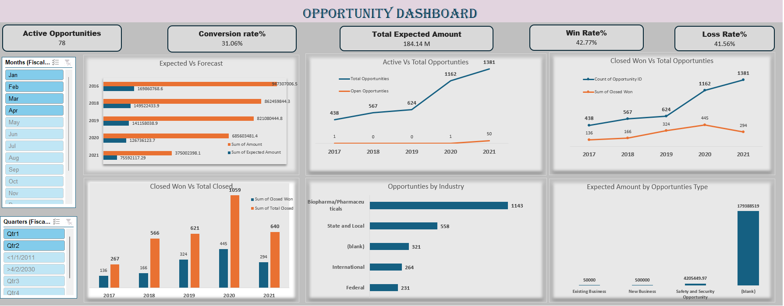
Excel Dashboard

Slide 6
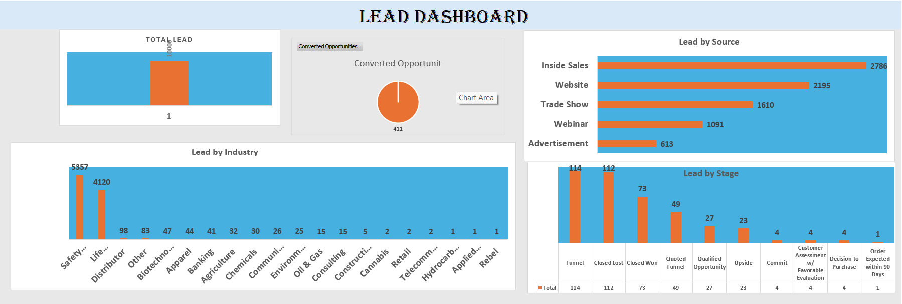
Excel dashboard

Slide 7
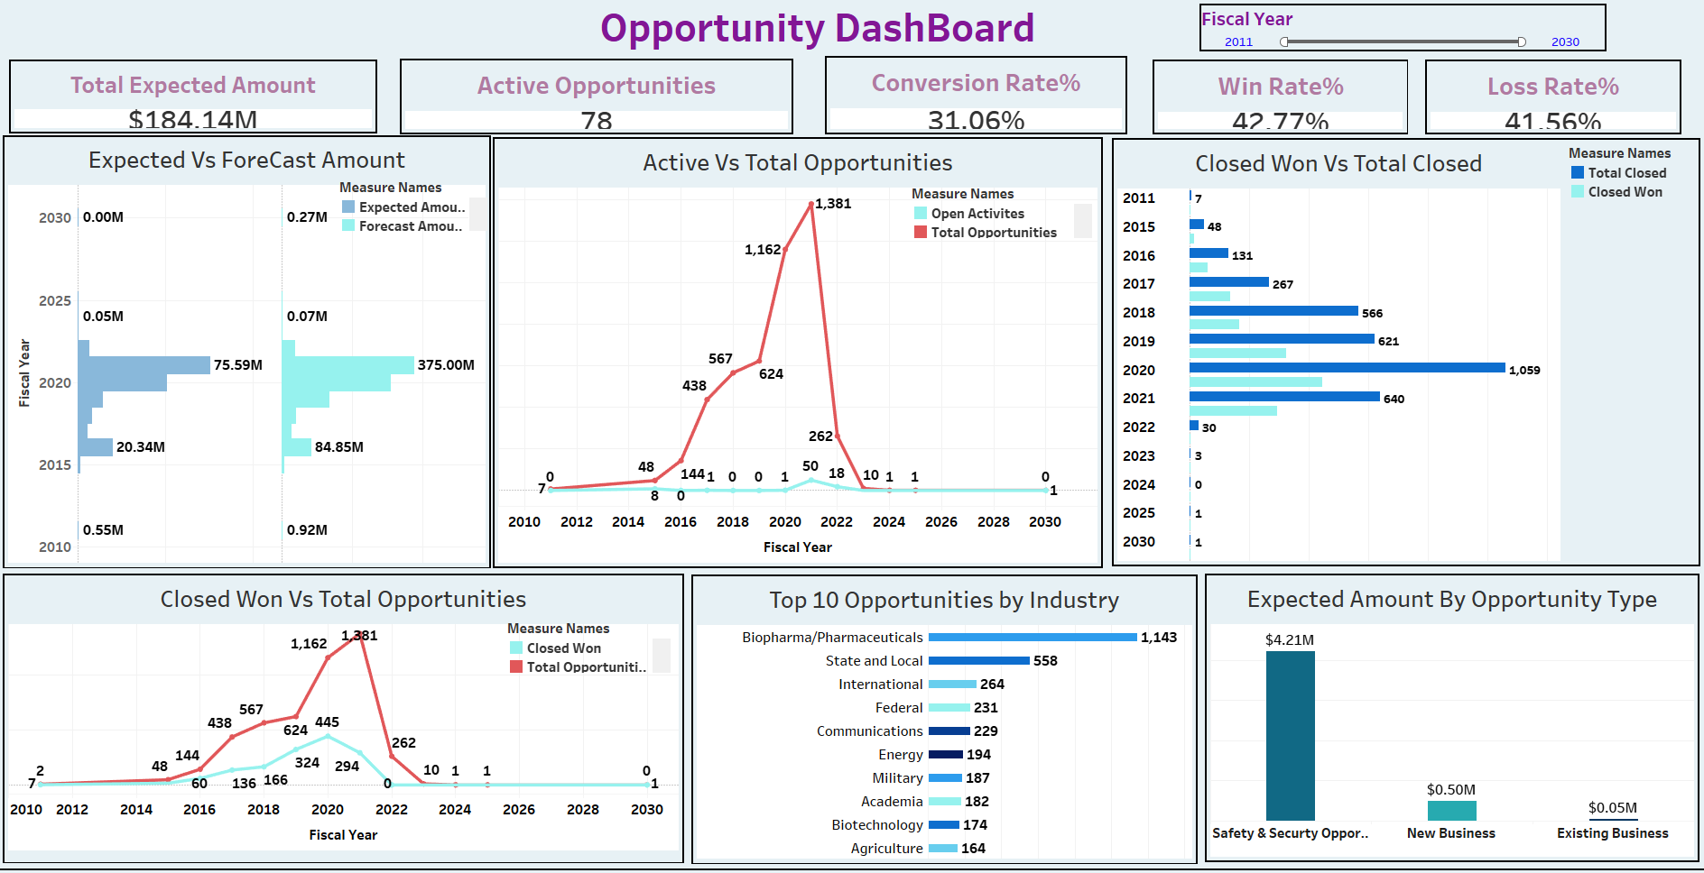
Tableau Dashboard

Slide 8
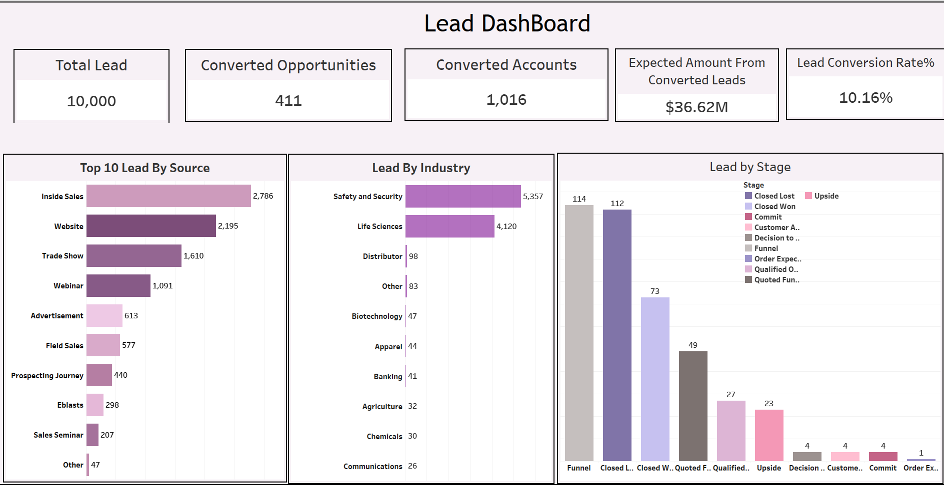
Tableau Dashboard

Slide 9
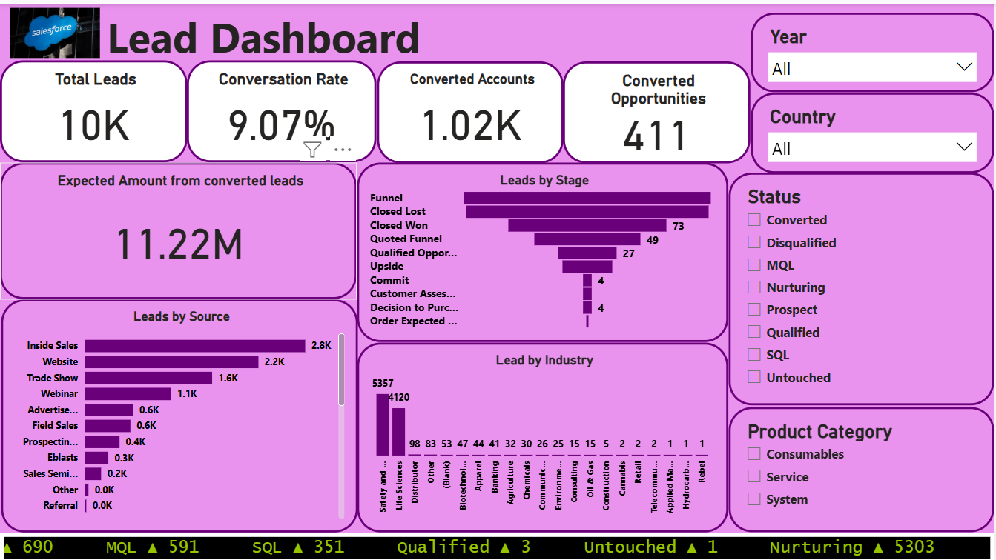
Power bi Dashboard

Slide 10
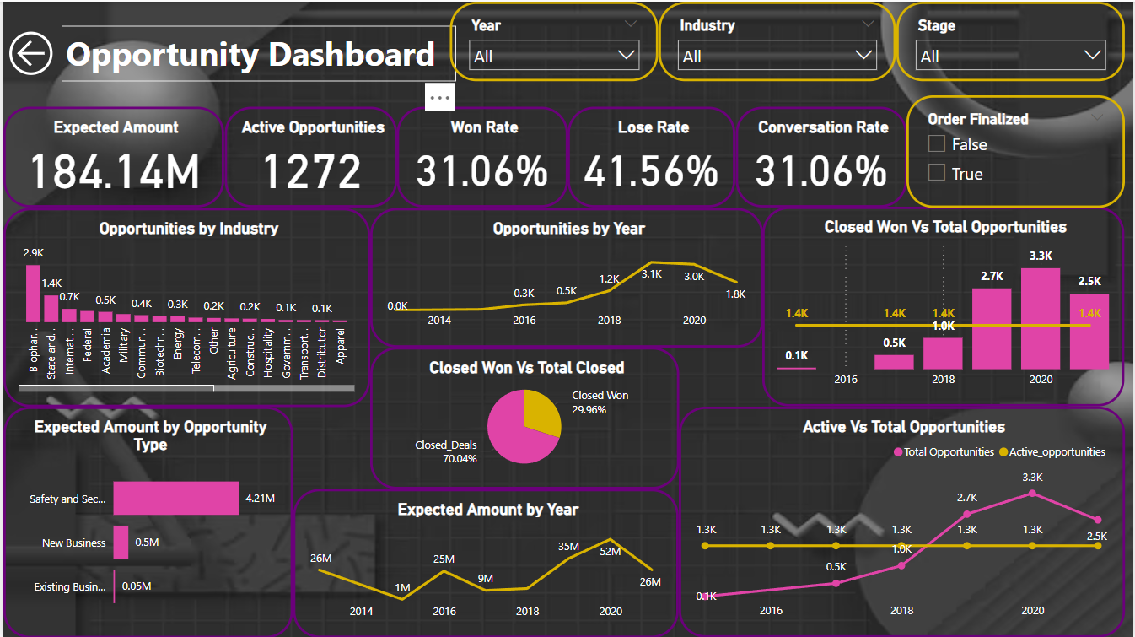
Power bi Dashboard

Slide 11
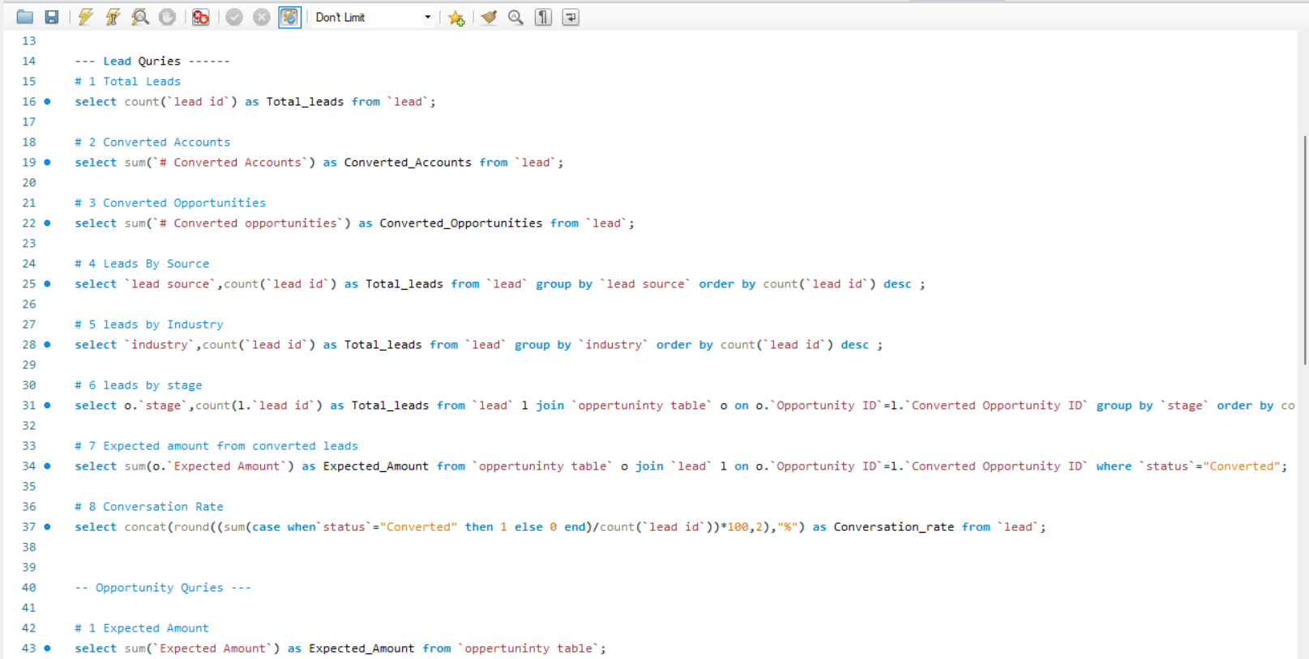
SQL Queries

Slide 12
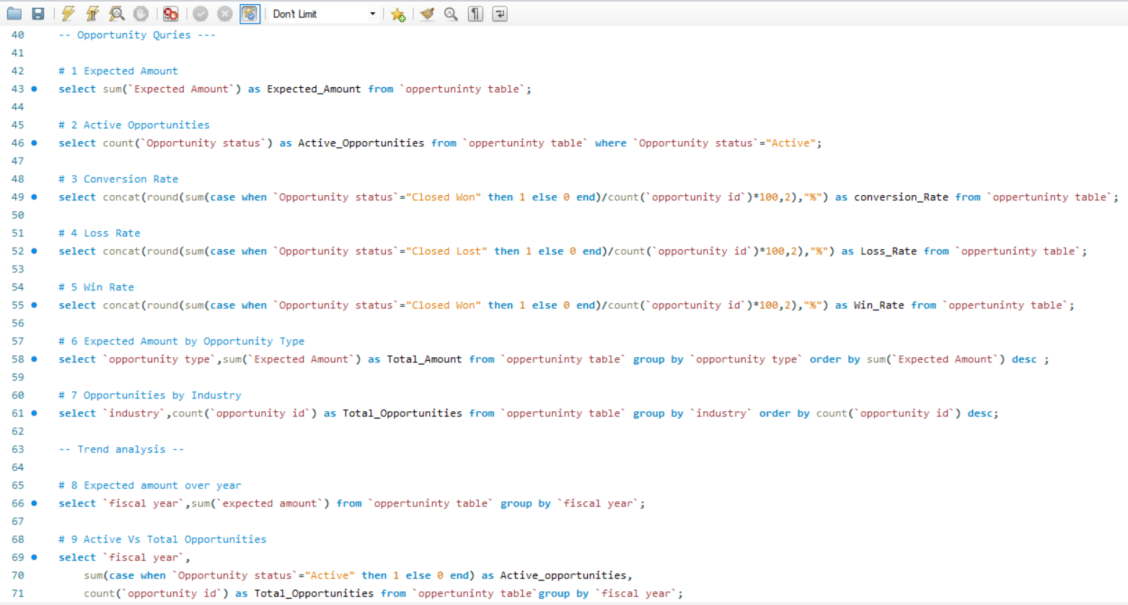
SQL Queries

Slide 13
Key take-aways
Metric | Key Value | Key Takeaway
Total Leads | 10K | Significant volume of leads captured.
Conversion Rate | 10.33% | Out of every 100 leads, around 10 convert.
Converted Accounts | 1,016 | Not all converted accounts lead to opportunities.
Converted Opportunities | 411 | Indicates a drop-off after account conversion.
Expected Revenue (Converted) | ₹36.62M | Strong revenue potential from converted leads.
Top Lead Source | Inside Sales (2,786) | Major contributor to lead generation.
Second Largest Source | Website (2,195) | Digital presence plays a key role in lead generation.
Lead Growth (2019-2021) | 3,765 → 5,156 | Significant surge in lead volume in recent years.
Top Industry (Leads) | Safety & Life Sciences (5,357) | Most leads come from this sector.
Second Largest Industry | Distributors (4,120) | Key sector for lead generation.

Slide 14
Steps to take:
Website and Inside Sales are the strongest lead sources, so focusing more on these channels could improve lead generation.
The conversion rate is around 10%, meaning there’s room for improvement in the lead nurturing process to push more leads toward conversion.
A significant surge in leads in 2020-2021 suggests improved marketing efforts, an increased online presence, or a rise in industry demand.
Safety & Life Sciences and Distributors industries drive most of the leads, making them key targets for further marketing strategies.
Seek feedback
Reflect on performance
Explore new techniques
Set personal goals
Iterate and adapt

Slide 15
Conclusion & Insights
Lead to Opportunity Conversion is Low
Total leads = 10K but converted opportunities = 411 (~4.1% conversion).
Inside Sales is the most effective lead source, while other sources like advertising and email campaigns contribute less.
The conversion rate of 9.07% suggests inefficiencies in lead nurturing.
Opportunity Win Rate Needs Improvement
The Won Rate is only 31.06%, while the loss rate is 41.56%, indicating potential issues in closing deals.
Closed Won vs. Total Closed = 29.96%, meaning nearly 70% of closed opportunities are lost or stalled.
Industry Focus Shows Variance
Biopharma & Safety Science dominates opportunities and leads.
Some industries have minimal engagement, presenting an opportunity for targeted campaigns.
Yearly Performance Shows Fluctuations
Expected amounts varied from $26M (2014) to $52M (2019), then dropped to $26M (2020).
The trend suggests external factors impacting revenue growth (e.g., economic shifts, pandemic effects).

Slide 16
Strategy for Improving Customer Retention & Conversions
Enhance Lead Nurturing & Qualification Process
Implement automated follow-up sequences for MQLs (Marketing Qualified Leads) before they move to SQL (Sales Qualified Leads).
Use AI-driven predictive analytics to prioritize high-value leads.
Optimize Sales Process to Increase Win Rate
Sales Training & Coaching: Equip sales reps with data-driven insights to handle objections effectively.
Personalized Sales Pitches: Customize presentations based on customer pain points.
Improve Customer Engagement & Experience
Introduce Customer Success Teams to maintain post-sale engagement and upsell/cross-sell.
Implement Loyalty Programs with exclusive benefits for repeat buyers.
Expand into Emerging Industries
Since Biopharma & Safety Science dominate, focus on expanding into underrepresented sectors like Consulting, Chemicals, and Retail.
By implementing these strategies, the company can significantly improve customer retention, boost conversion rates, and maximize revenue potential.

Slide 17
Thank you

